Slide 1
Unusual Objects on the Road
Tanner Fry, Basil Al Zamil, Xilun Guo

Slide 2
About the Project
Using Cityscapes analysis tools and their database of image processing algorithms
Our theory is based on the Tesla crash in June 2016
It was determined that the software used in the Tesla vehicle incorrectly registered a Semi-truck as a cloud due to the angle of sunlight reflecting off of it.
We theorize that a problem exists in image recognition software in most self-driving cars
Specifically in handling unknown/unusual objects, hazardous weather, and bad lighting

Slide 3
Design goal
Our goal is to compile a set of images from the perspective of an autonomous car that cause a large portion of image recognition algorithms to fail.
Datasets

Slide 4
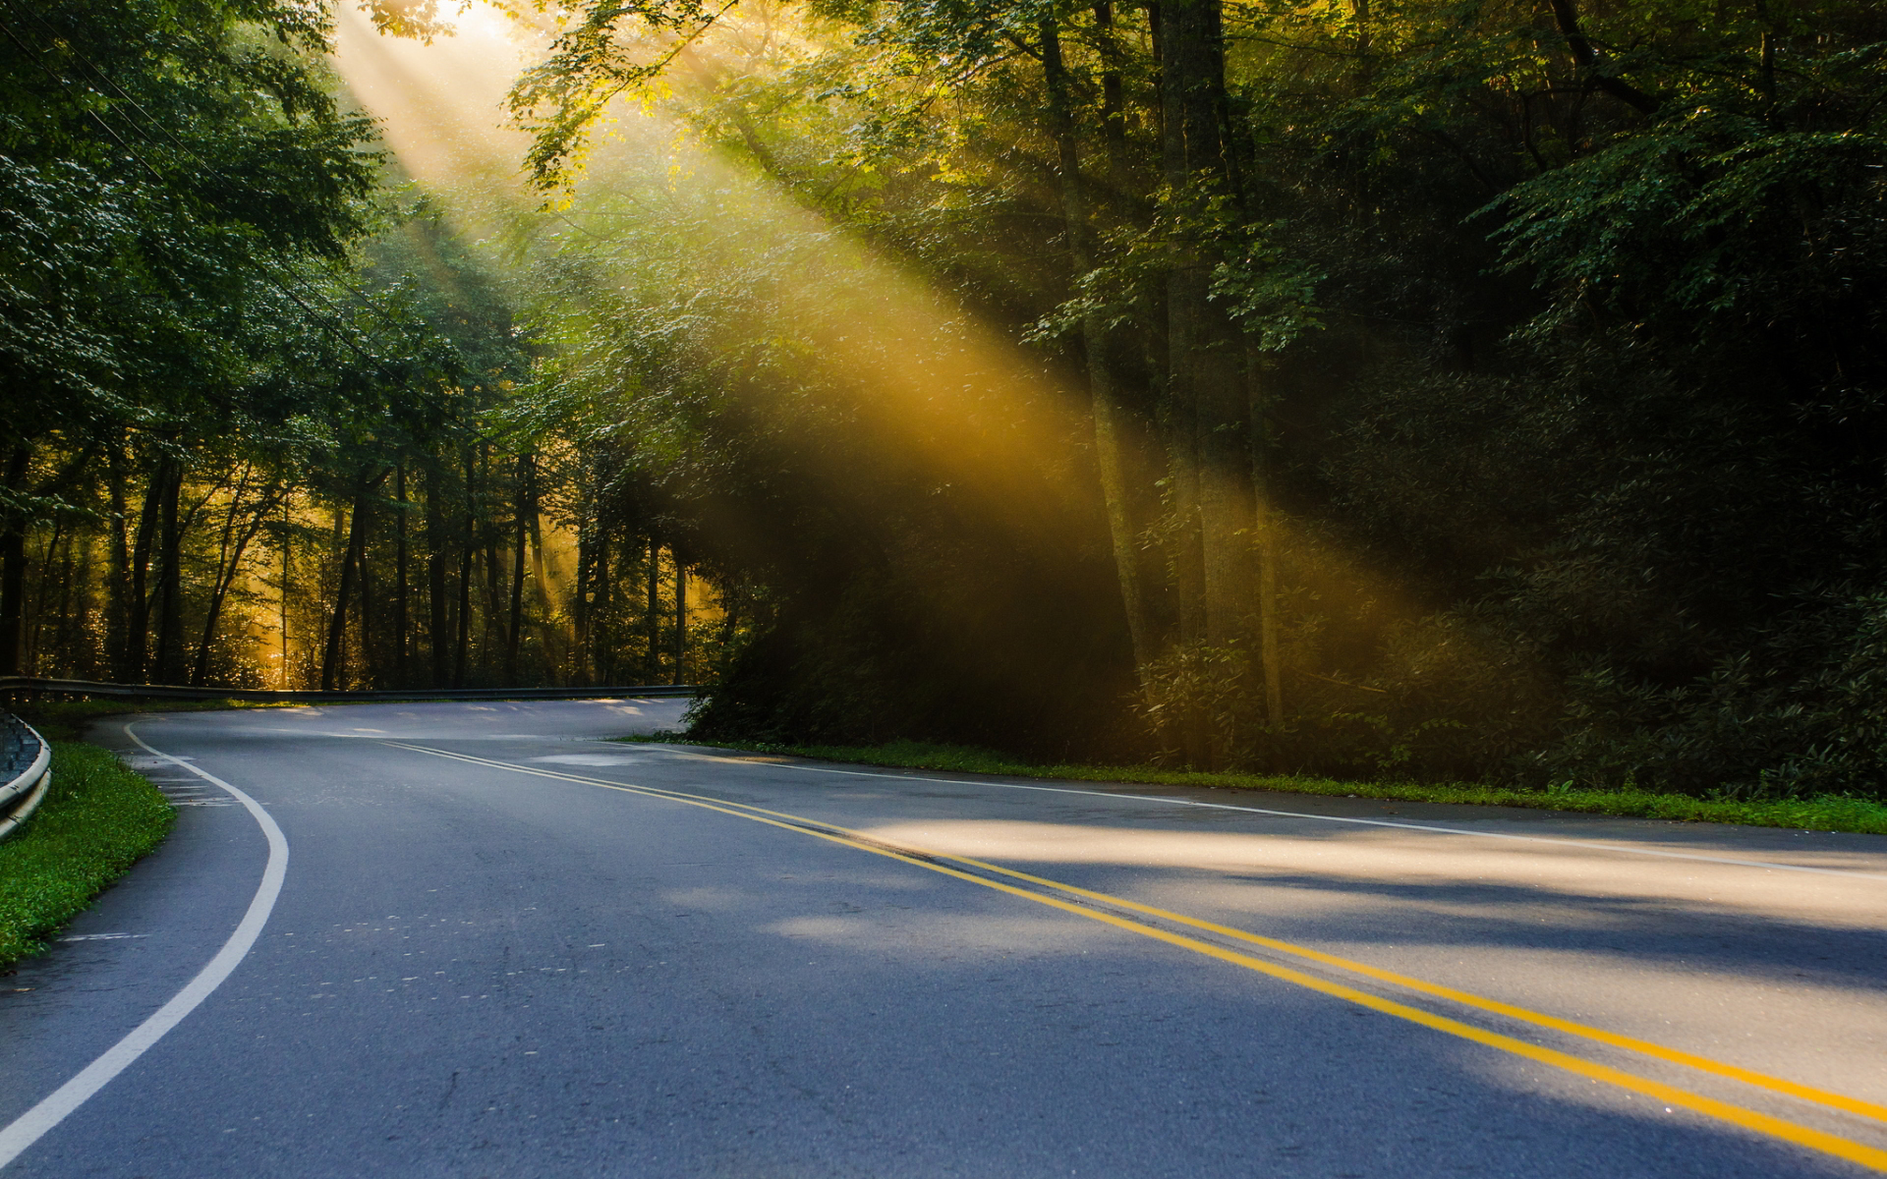
Datasets
Create many test cases from camera footage to find areas of fault.
We are compiling these images and video feeds into a single dataset that has many cases of failure in the algorithms we test.

Slide 5
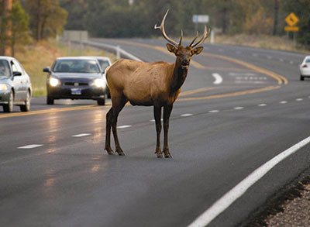
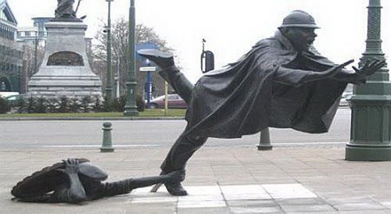
Objects that might cause failure: Odd statues and animals
Federal Highway Agency

Slide 6
Testing Design
Our end objective is to methodically test the available image recognition algorithms (linked from the Cityscapes website) to either confirm areas of fault or determine that the algorithm is flawed.
To do this we will create a matrix of potential lighting and weather situations as the X-axis and unusual objects as the Y-axis.
This will allow us to create a matrix with a varying number of rows depending on the object we find that are unrecognizable by the algorithm.
By referencing the rows and columns we can determine which object or condition is causing fault

Slide 7
Testing Design Continued...
Using the matrix system to record and gather data we can then verify if the object is the issue or the lighting/weather is to blame (or both).
We can do this by running datasets with both cases individually and then in parallel to compare behavior and response of the algorithm.
Thus have better feedback and understanding of the algorithm faults.
Along with that it will give us a better idea of what to change should we choose to edit the algorithm ourselves.

Slide 8
Progress
Did all required document work
Researched methods to collect and analyze data
Created a plan for how to test our theory on image algorithms
Began collecting data to test with
Fall Term

Slide 9
Progress
We have successfully completed/updated any and all documents as needed
Found optimal software to use and alternative tools
Gained access to the OSU Steed Server to run Algorithms
Have two algorithms setup and running
As of mid Winter Term

Slide 10
Week 1 Winter Term
Touched base with group
Organized schedule for meetings
Began work on how to analyze algorithms from the data collected

Slide 11
Week 2 Winter Term
We needed a concurrent work place that we all had access to and that we could control all of the environment variables
Initial plan was to get a Linux box and have it setup so we can SSH into it and do our work remotely
Dr. Li suggested we use the OSU server Steed that has built in GPU acceleration
We started to transition to using the server which will work out better in the long run

Slide 12
Week 3 Winter Term
Met with Jialin one of Dr. Li’s grad students
She helped us get access to the Steed server and showed us how to run algorithms
Got a base test running with the Berkeley FCN algorithm
Our personal access is still blocked so we have to work with Jialin for now

Slide 13
Week 4 Winter Term
Tough week for progress
Ran into roadblocks with the Steed server
Took a while to gain full access
Bashrc file lines were required to exist in a group on the server to have full rights
A line in the bashrc file was causing an infinite process loop that was blocking our ability to work on the server
Uploaded images to server to begin testing
Overall a very technical week with lots of roadblocks

Slide 14
Week 5 Winter Term
Jacky and I did a decent amount of working getting the FCN algorithm more put together.
It runs and we have results, however we had not applied a learning model to it so it only found cars and roadways
Got most of the setup done for the pyramid scheme algorithm
Met with Dr. Li and discussed roadblocks and where we are headed for the remainder of the term
Met with Jialin to help fix FCN algorithm

Slide 15
Remaining Work
One or Two more algorithms setup and testing.
Creating matrix to organize the result images and actual images within different conditions.
Analyze from the matrix, and report if there some images brake the algorithms or all get passed.
Upload as a test file including all images the algorithms fail to recognize something in order to have people to improve their algorithms.

Slide 16
Problems Encountered
Permission deny from the steed sever.
Fail to run the algorithms.
Not expected images results from the output.

Slide 17
To Recap

Slide 18
Project Goals
Thoroughly test multiple image recognition algorithms used for self-driving vehicles to determine if there are global areas of fault in the algorithm design.
Hopefully find these areas of fault in the algorithms and fix them, or send enough feedback to the designers so that the problems can be fixed.

Slide 19
Current Status
We have completed all the documentation work up to this point.
Researched the best hardware, software, and methods for completing our research objective.
Have collected many hours of footage for testing purposes
Have two algorithms working
Starting running test sets on algorithms from the Steed Server

